Slide 1
KNOWLEDGE INSTITUTE OF TECHNOLOGY
Smart phone evolution.
Presented by:
S.ABARNA .

Slide 2
Introduction SMART PHONE EVOLUTION
In past,mobile phones were mostly about making phone calls. Now smart phones offer so much more ,that can fit into your pocket.

Slide 3
History of mobile phones
In 1973,Dr.martin cooper of motorola is the inventor of first practicle mobile phone.
In 1G,we transferred the information through analog technology.
In 2G,we transferred the information through digital technology
In 3G,which we are using currently in our phones. It is very easy to access the information . we can transfer our data,emails,instant message,ect,.

Slide 4
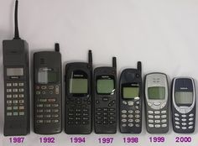
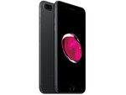
Manufactures of mobile phones
Motorola was the vibrating alert functions .
Before -Sony,panasonic,nokia,ect,..
Now- Oppo f1,lenova k5,samsung galaxy , Apple…...

Slide 5
Characteristics of smart phones
TODAY SMART PHONES ARE ABLE TO ACCESS
Internet
Exchange email
Twitter ect,…
Smart phones cost more than conventional cell phones ,but offer users much more functionality.

Slide 6
Advantages of smart phones
Provide direction through
GPS.
Take pictures and play musics.
Keep track of appoinments and contacts.
Through the installation of apps , the list of possible smartphones uses multiplies by tens of thousands and grows longer everyday.

Slide 7
Strength of the smart phones
According to the pew internet and American life project,
Nearly half of the American adults are smart phone owners.
The implication of business is that they can increase worker efficiency by making use of smart phones.
Productivity applications
Email accessibility.

Slide 8

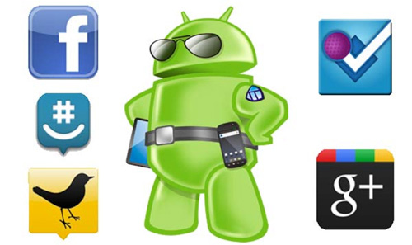
Productivity applications
Eliminate paper work and save time.
Apps can be purchased and download separately,when apps can’t be installed.
Beyond GPS, smart phones enable to work with word,spreadsheet,presentation and PDFsoftware.

Slide 9
Email accessibility
Review,read and respond to emails using smart phones.
According to Mobile Future Institute, more than 70% of workers using smart phones.
They can take advantage of email app while waiting for meeting to begin.

Slide 10



Pros of smart phones
Communication tools
Voice calling,instant messaging across several popular programs.
Productivity tools
Offers many tools at our fingertips
Employees access info while on off_site job, at home or from work.

Slide 11
Cons of smart phones
Also include some notable drawbacks,
Making monthly bill more expensive.
Internet access on insecure network puts you at risk of hacked accounts.
Smartphone users often play on device during seminors,rather than focusing on presentation.

Slide 12
Conclusion
In conclusion ,
Smart phones have changed society insuch that life become easier.
More accessible,however, people becoming anti_social due to the invention of smart phones is increasing.
Poor academic performance of students is also because of using smart phones.

Slide 13
We have to know how to use and when to use the smart phones.
Thank you for listening

